Slide 1
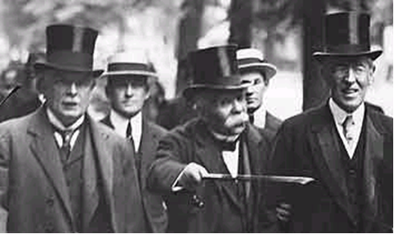
The Treaty of Versailles-Good Times
.

Slide 2
Pre-Versailles Germany – not good times
By 1918 the average German was living on 1000 calories a day---1/2 the amount needed for a normal diet
Coal was in short supply, gas was non-existent, and electricity was nowhere to be found
In many cities public buildings, cinemas and theatres were shut down

Slide 3
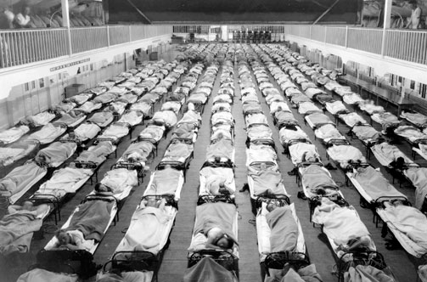
Spanish Influenza – Not Good Times
- A killer virus, Spanish Influenza, swept across Europe during the summer of 1918.
- Weak from years of hunger, 400,000 German civilians and 186,000 soldiers died in less than a year.

Slide 4
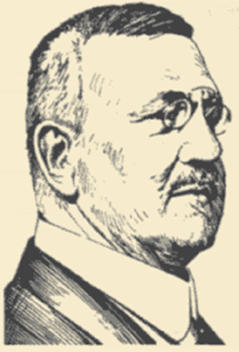
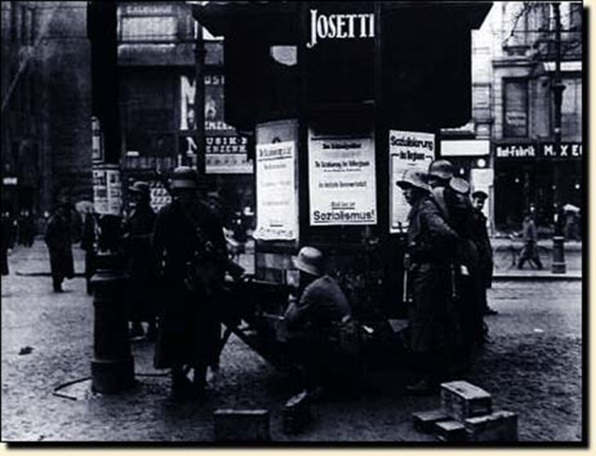
The Kapp Putsch March 1920
Wolfgang Kapp, an extreme nationalist hated the government for signing the treaty of Versailles. He seized control of the government on the 13th. of March.
He would make the German army stronger.
He would give back Germany’s pride.
He would take back the land given to Poland by the Treaty. Sound Familiar?
Kapp did not have the workers on his side.
They organized a general strike against him and paralyzed Berlin. After 100 hours in power he fled to Sweden.

Slide 6
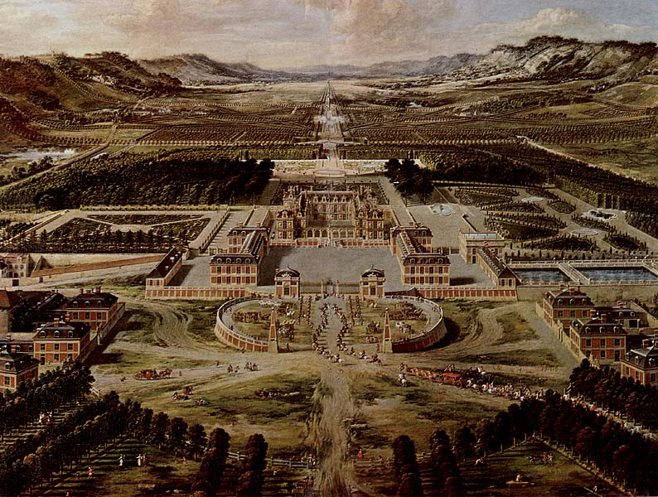

Slide 7
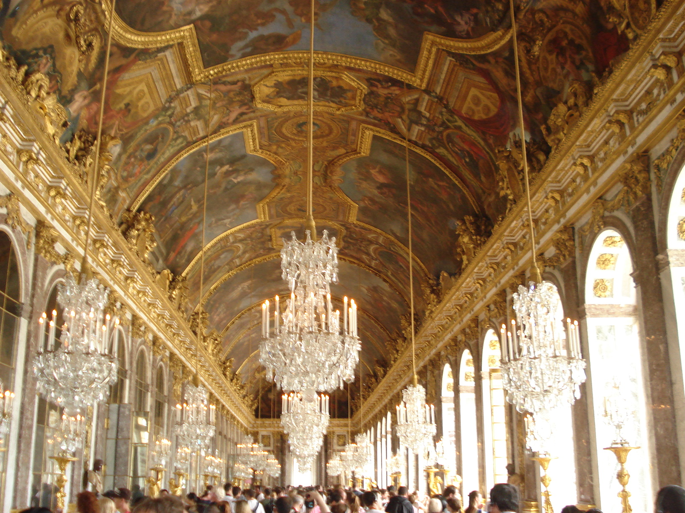

Slide 8
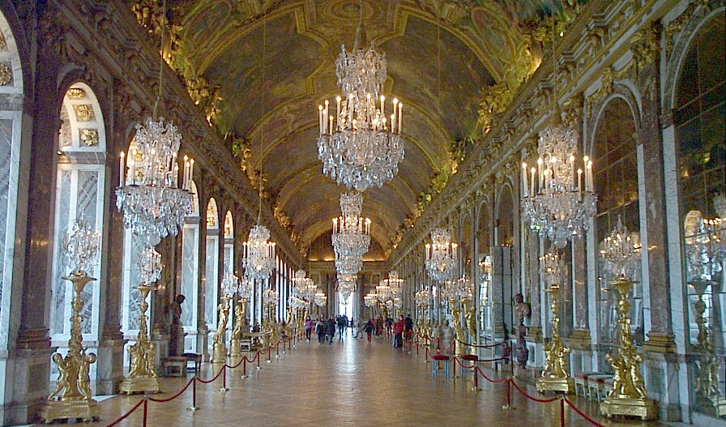

Slide 9
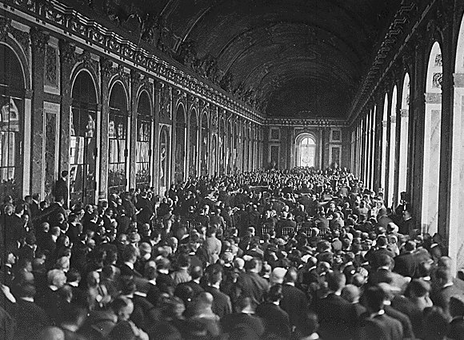

Slide 10
B.R.A.T
BLAME – Clause 231
Reparations – 6,600 millions pounds
ARMY – restrictions – defenceless Germany
Territory
CP – Germany was Shrunk, Split, Disarmed and Broke!

Slide 11
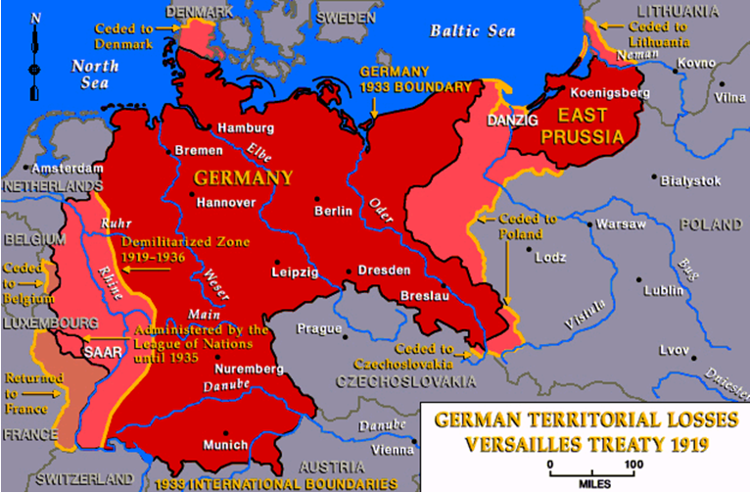

Slide 12
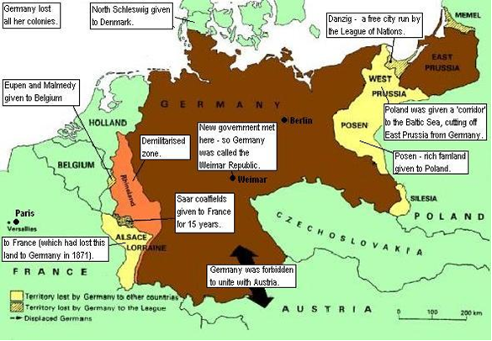

Slide 13
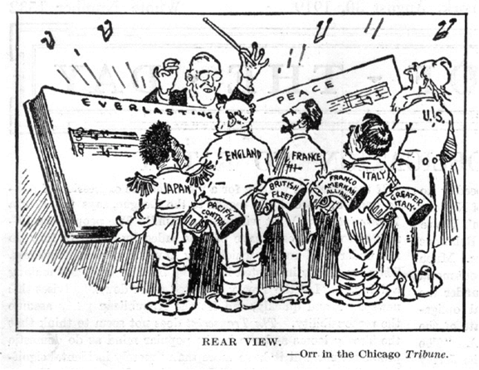

Slide 14
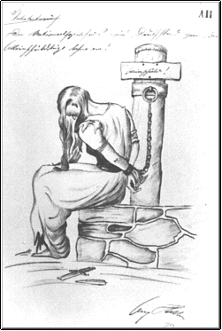

Slide 15
The League of Nations

Slide 16
Collective Security - Failed
NO Army
NO USA – Congress will not ratify – Isolationism
Economic Sanctions do not work
Old Imperial Power Perception- looked like Britain and France just doing the same old thing

Slide 17
Failure of Manchuria 1931 – and Ethiopia 1935
http://www.youtube.com/watch?v=n-rnwZCJTOE&feature=fvw
http://www.youtube.com/watch?v=QtxL3idYS6k

Slide 18
1923 Occupation of the Ruhr
French and Belgian forces went in to force the German workers to produce products so the Allies could collect reparations
It did not really work. There was passive resistance, strikes. The French tried bringing in there own workers. The occupation of the Ruhr led to a collapse of the German economy
http://www.youtube.com/watch?v=s5xO3mHIKbk&feature=related

Slide 19
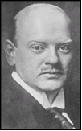
What solved the Problem?
Stresemann – Economics advisor, accepted The Dawes Plan (USA)
USA lends Germany $$$ - gets products rolling again – Germany then could pay reparations – USA could then get their War Debts back
Dawes Plan
$$$$$
French and Belgians Leave – Production resumes

Slide 20
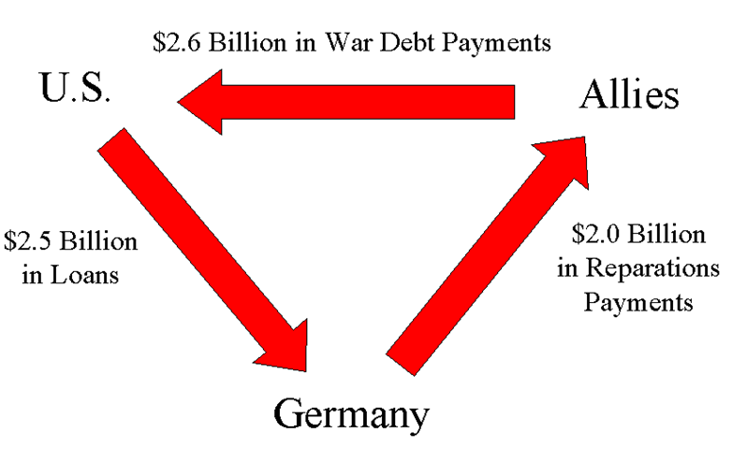

Slide 21
Germany on the Way Back!
1922 – WASHINGTON CONFERENCE: Agreement to limit size of navies. Brit=5; USA=5; Japan=3; France and Italy=1.67. No provision for inspection.
1925 – LOCARNO TREATY: Britain, France, Belgium, Germany and Italy agree to respect each other’s boarders. Germany admitted to the League of Nations – optimism.
1926 – Germany admitted as a full member to the League of Nations
1928 – KELLOGG/ BRIAND PACT: 15 nations agree to renounce war except in self-defense.

Slide 22
France’s Search for Security
- It took until 1925 to rebuild destroyed France.
- Heavily depended on reparation payments from Germany
- Were still very afraid of Germany even in its weakened state.
- Built the Maginot Line, a series of steel and concrete forts along the French boarder stretching from Belgium to Switzerland.
- Established the Little Entente with Poland, Rumania, Czechoslovakia, Yugoslavia
Still had the De-Militarized Rhineland, and Reparations

Slide 23
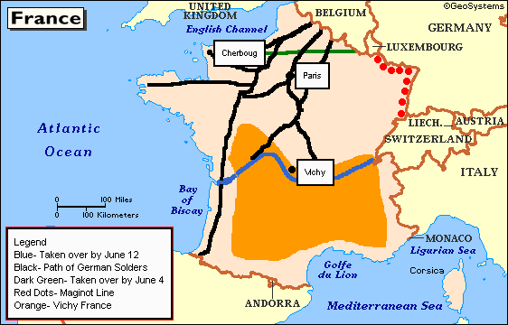

Slide 24
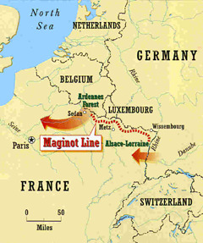
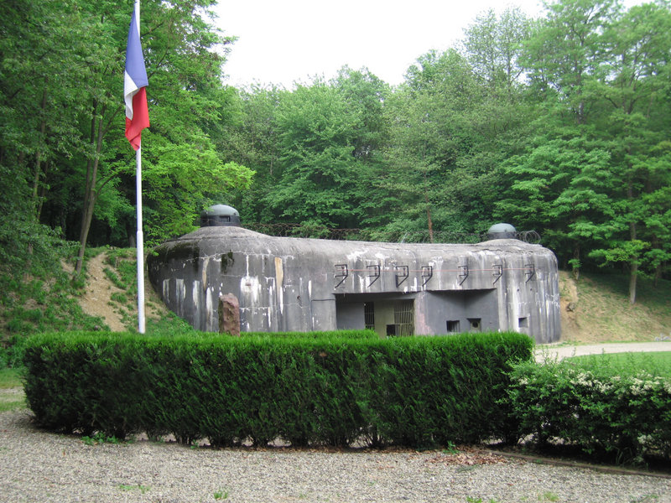
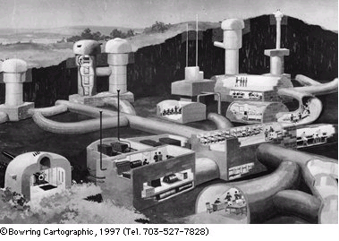
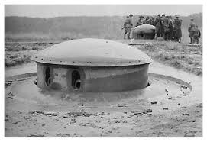

Slide 25
So, Why did the Weimar Republic Fail?
1. Germans had no real experience in democratic government.
2. The Weimar government had to enforce the Treaty of Versailles.
3. There were too many political parties
4. The Depression hit Germany hard
http://www.youtube.com/watch?v=XEt7PLQpjXY&feature=related

