Slide 1
Secondary PowerPoint 3:
Governments in Canada

Slide 2
What do you know about the structure of government in Canada?

Slide 3
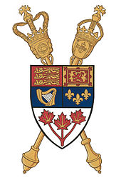
Parliamentary Democracy
Canada is a parliamentary democracy; we elect representatives to our federal parliament and provincial and territorial legislatures to make laws
These elected representatives are usually associated with a political party (a group of individuals with a shared vision and similar political beliefs whose intention is to achieve power)
The party with the most representatives forms government and their leader becomes the head of the government

Slide 4
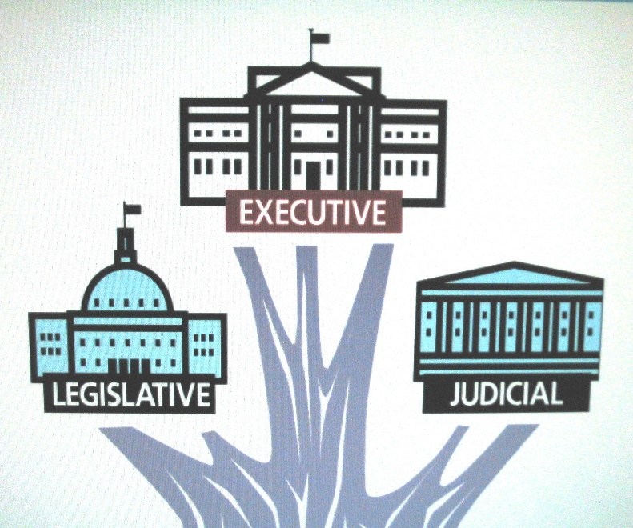
Three Branches of Government
In a parliamentary system, there are three branches or divisions:
Executive (creates policies and implements legislation)
Legislative (passes legislation)
Judicial (oversees and interprets laws)

Slide 5
Executive Branch
Responsible for creating policies and implementing laws, rules and regulations
Consists of the monarch, the head of the government and cabinet, and the public service
FEDERAL: The monarch is represented by the governor general and the head of government is called the prime minister
PROVINCIAL: The monarch is represented by the lieutenant governor and the head of government is called a premier
The head of government appoints several elected representatives to lead the departments or ministries of the executive council (cabinet)

Slide 6
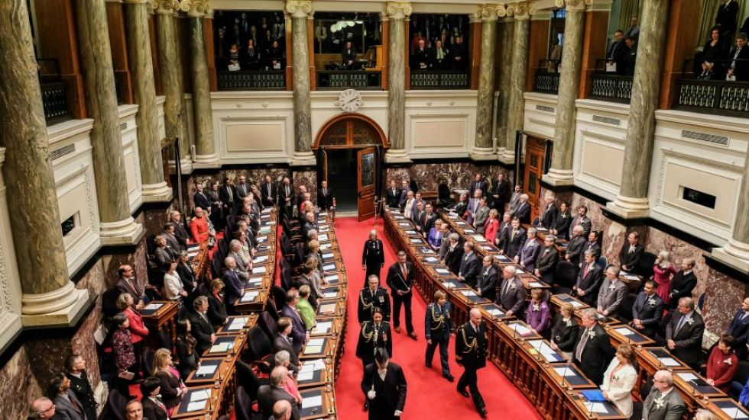
Legislative Branch
Responsible for debating, amending and passing laws, with approval by the Crown
FEDERAL: includes two houses, made up of elected members of Parliament (MPs) in the lower house and appointed senators in the upper house
PROVINCIAL: only has one house, made up of elected members of the Legislative Assembly (MLAs)

Slide 7
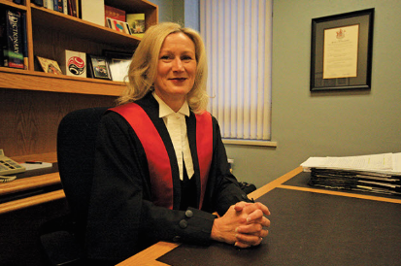
Judicial Branch
Interprets the law and punishes those who violate established laws, rules and regulations
FEDERAL: Supreme Court of Canada headed by nine appointed judges, Federal Court of Canada, and Tax Court of Canada
PROVINCIAL: BC Court of Appeal headed by the Chief Justice of BC, the Supreme Court of BC and BC Provincial Court
The judicial branch operates independently and separately from the executive and legislative branches of government

Slide 8
Why do you think it is important for our government to be divided into three branches?

Slide 9
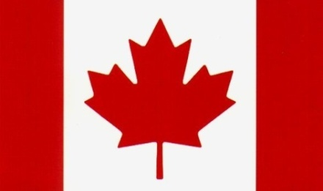
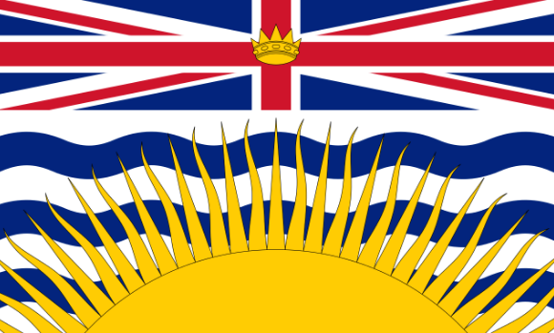
Federal vs. Provincial
Title given to the elected member | Member of Parliament (MP) | Member of the Legislative Assembly (MLA)
Number of elected members | 338 | 87
Title of the head of government | prime minister | premier
Name of the legislative body | House of Commons | Legislative Assembly
The monarch’s representative | governor general | lieutenant governor

Slide 10
What other levels of government exist in Canada?

Slide 11
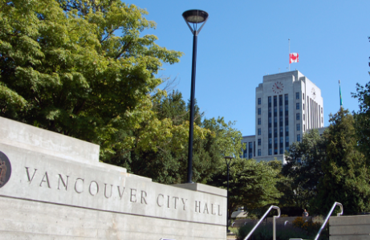
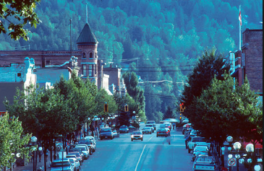
Local Governments
The local government system in B.C. includes municipal governments, regional districts and improvement districts
The elected representative at the municipal level is called a councillor
The head of the council is called a mayor and they elected by citizens
Municipal councils debate and pass laws at the city or town hall
The size and structure of the council differs depending on the population it represents

Slide 12
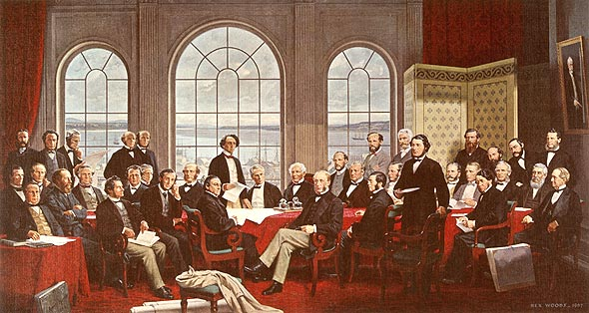
Division of Powers
When they chose a federal form of government, the Canadian Fathers of Confederation assigned particular responsibilities to the federal and provincial governments (outlined in Sections 91–95 of the Constitution Act)
This division of powers is based on the idea of subsidiarity, meaning that the government level closest to the issue governs it
Local governments receive their powers from the provincial government

Slide 13
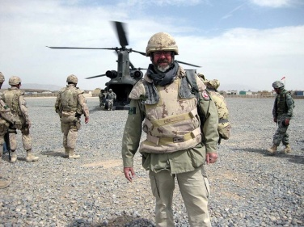
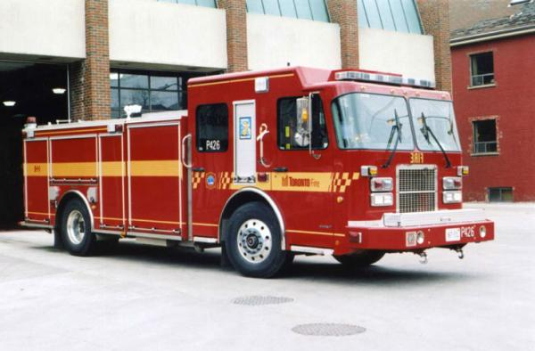
Examples of Government Responsibilities
Federal: Global affairs, immigration and citizenship, national defence, currency, public safety, fisheries and oceans
Provincial: Education, health care delivery, social welfare, transportation and highways
Municipal: Roads and bridges, water and sewer service, recreation and community facilities, libraries, police services

Slide 14
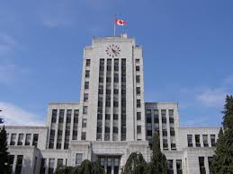
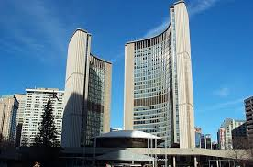
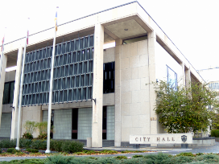
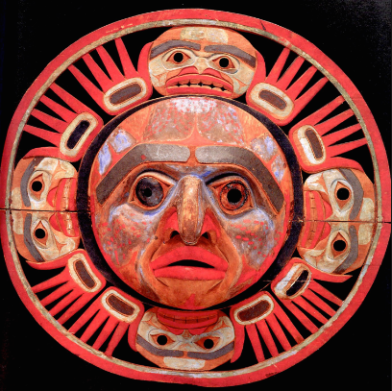
Municipal/Local
Indigenous Governments
The elected representative at the municipal level is usually called a councillor.
Municipal councils debate and pass laws at the local or city town hall.
The head of the council is called a mayor or reeve.
The size and structure of the council differs, depending on the population.
Indigenous communities or First Nations reserves have their own governments which replace or share certain responsibilities with the provincial/territorial or federal government
The term self-government refers to a First Nation, Métis or Inuit community with control over its own affairs
Self‑governing First Nations have the ability to sign treaties (formal agreements) and comprehensive land claims agreements (modern treaties)

Slide 15
Debrief
How does government impact you on a daily basis?
Which level of government has the greatest impact?
Why is it important to know who your local representative is?

